Slide 1
Understanding the Software Development Life Cycle (SDLC)
Understanding the Software Development Life Cycle (SDLC)
- Sunny Barve

Slide 2
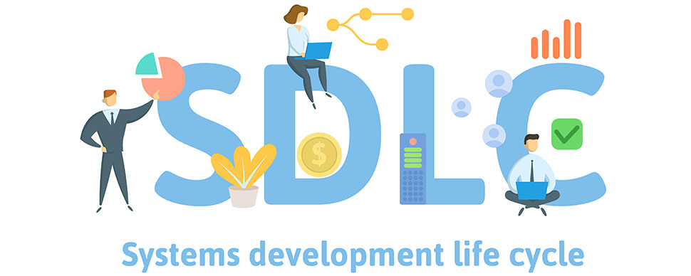
What is SDLC ?
SDLC is a systematic process for developing, operating, maintaining, and replacing software.
It ensures a structured approach to software development, leading to better quality and efficiency.
Common phases include planning, analysis, design, development, testing, implementation, and maintenance.

Slide 3
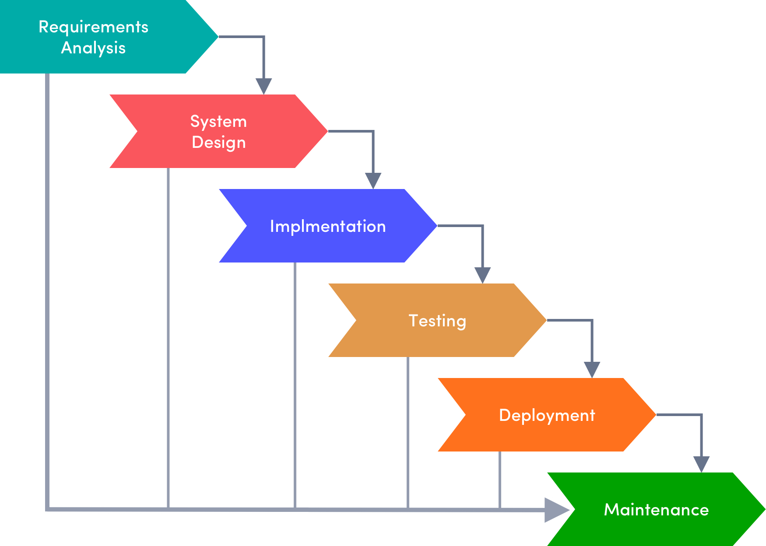
Key phases in SDLC include:
Planning: Defining project goals, scope, and requirements.
Analysis: Gathering and analyzing user needs and requirements.
Design: Creating detailed specifications for the software's architecture, components, and interfaces.
Development: Building the software code based on the design specifications.
Testing: Verifying and validating the software's functionality, performance, and quality.
Implementation: Deploying the software into production.
Maintenance: Ongoing support, updates, and enhancements to the software.

Slide 4
Traditional SDLC Models
Waterfall Model:
Sequential approach where each phase must be completed
before the next begins.
Can be rigid and less adaptable to changes.
V-Model:
Similar to Waterfall, but emphasizes testing at each stage.
Provides better quality control but can still be inflexible.
.
.

Slide 5
Iterative and Spiral Models
Iterative Model:
Development is divided into smaller iterations, each producing a working product.
Allows for early feedback and reduces risks.
Spiral Model:
Combines elements of Waterfall and iterative models.
Emphasizes risk management and flexibility.

Slide 6
Choosing the Right Approach
Waterfall Model:
Not recommended for most modern software projects due to its rigidity and lack of adaptability.
V-Model:
Recommended for projects where quality assurance is important, such as safety-critical systems.
Iterative Model:
Recommended for most software projects due to its flexibility and ability to accommodate changes.
Spiral Model:
Recommended for large, complex projects with high risks, such as mission-critical systems.

